Slide 1
MODULE 2: 5G Network Architecture
M2 S5
Network Slicing:

Slide 2
Network Slicing
From the 3GPP point of view, a 5G network slice is viewed as a logical network with specific functions/elements dedicated for a particular use case, service type, traffic type, or other business arrangements with agreed upon service-level agreement (SLA).
It is important to note that 3GPP only defines network slicing for 3GPP defined system architecture and does not address transport network slicing or resource slicing of components.

Slide 3
Network Slicing
5G System architecture
The most commonly discussed slice types in industry are enhanced Mobile Broadband (eMBB), Ultra-Reliable Low Latency Communications (URLLC), and massive IoT (mIoT).
However, there could be many more network slices.
In 4G systems there is an optional feature called eDecor to support Dedicated Core Networks (DCNs) to allow selection of the core networks based on UE’s subscription and usage type.
The network slicing in 5GS is more complete solution that provides capabilities for composing multiple dedicated end-to-end networks as slices..

Slide 4
Network Slicing
5G System architecture
An end-to-end Network Slice includes the Core Network Control Plane and User Plane Network Functions as well as the Access Network (AN).
The Access Network could be the Next Generation (NG) Radio Access Network described in 3GPP or the non-3GPP Access Network with the Non-3GPP Inter Working Function (N3IWF) or Trusted Non-3GPP Gateway Function TNGF, or the Trusted WLAN Interworking Function (TWIF) to the trusted WLAN (in case of interworking with Wire line Access Network, it will be Wire line Access Gateway Function (W-AGF)).
To emphasis that there could be multiple instances of a network slice, the 3GPP 5GS specifications define the term ‘Network Slice instance’ as set of Network Function instances and resources (e.g., compute, storage, and networking resources) which form a Network Slice..

Slide 5
Network Slicing
5G System architecture
In 5GS, the Network Slice Selection Assistance Information (NSSAI) is a collection of identifications for network slices.
A network slice is identified by a term referred to as Single-NSSAI (S-NSSAI).
The S-NSSAI signaled by the UE to the network assists the network in selecting a particular Network Slice instance.
An S-NSSAI is comprised of a Slice/Service type (SST) and an optional Slice Differentiator (SD) which may be used to differentiate among multiple Network Slices of the same Slice/Service type..

Slide 6
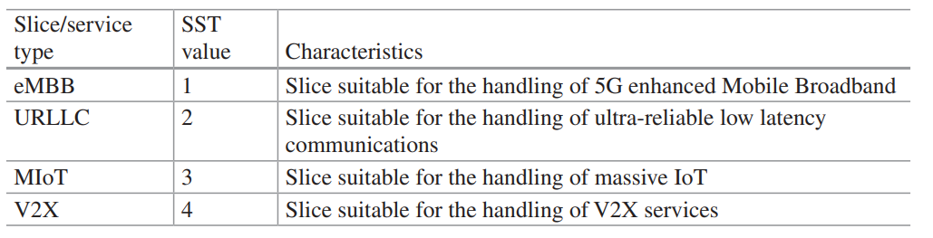
Network Slicing
5G System architecture
An S-NSSAI can have standard values or non-standard values.
The S-NSSAI with standard value means that it is comprised of an SST with a standardized SST value.
An S-NSSAI with a non-standard value identifies a single Network Slice within the PLMN with which it is associated..

Slide 7
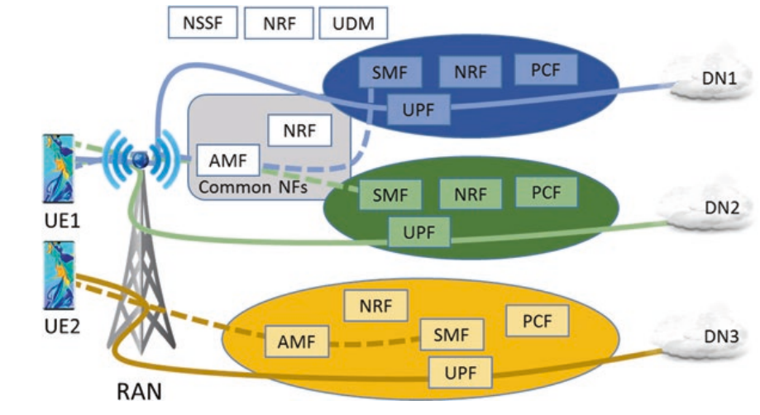
Network Slicing
5G System architecture
A network may serve a single UE with one or more Network Slice instances simultaneously via a 5G-AN.
Figure shows an example of three Network Slices in 5GS.
For Slice 1 and Slice 2, the Access and Mobility Management Function (AMF) instance that is serving the UE1 and UE2 is common (or logically belongs) to all the Network Slice instances that are serving them.
The UE in Slice 3 is served by another AMF.
Other network functions, such as the Session Management Function (SMF) or the User Plan Function (UPF), may be specific to each Network Slice..

Slide 8
Network Slicing
5G System architecture
The Network Slice instance selection for a UE is normally triggered as part of the registration procedure by the first AMF that receives the registration request from the UE.
The AMF retrieves the slices that are allowed by the user subscription and may interact with the Network Slice Selection Function (NSSF) to select the appropriate Network Slice instance (e.g., based on Allowed S-NSSAIs, PLMN ID, etc.).
The NSSF contains the Operators’ policies for slice selection. Alternatively, the slice selection policies may be configured in the AMF. It is also possible for the Home PLMN to provision the UE with Network Slice selection policy (NSSP) as part of the URSP (UE Route Selection Policy) rules...

Slide 9
Network Slicing
5G System architecture
The data connection between the UE and Data Network (DN) is referred to as PDU session in 5GS.
In 3GPP standards, a PDU Session is associated to an S-NSSAI and a DNN (Data Network Name).
The establishment of a PDU session is triggered when the AMF receives a Session Management message from UE.
The AMF discovers candidate Session Management Functions (SMF) using multiple parameters (including the S-NSSAI provided in the UE request) and selects the appropriate SMF....

Slide 10
Network Slicing
5G System architecture
The selection of the User Plane Function (UPF) is performed by the SMF.
The Network Repository Function (NRF) is used for the discovery of the required Network Functions using the selected Network Slice instance The data transmission can take place after a PDU session to a Data Network is established in a Network Slice.
The S-NSSAI associated with a PDU Session is provided to the (R)AN, and to the policy and charging entities, to apply slice-specific policies.....

Slide 11
Network Slicing
5G System architecture
For roaming scenarios, S-NSSAI values applicable in the Visited PLMN (VPLMN) depend on if the UE only uses standard S-NSSAI values or not.
If UE is using the standard S-NSSAI values, then Home PLMN (HPLMN) S-NSSAI values will be used in Visited PLMN (VPLMN).
If there is an SLA between the Visited and Home networks to support non-standard S-NSSAI values, then the NSSF in VPLMN maps the Subscribed S-NSSAIs values to the S-NSSAI values that are to be used in the VPLMN.
It is also possible for the visited operator to set policy and the configuration in the AMF, in which case the AMF may decide the S-NSSAI values to be used in the VPLMN and the mapping to the Subscribed S-NSSAIs......

Slide 12
Network Slicing: Concept and Implementation;
Network slicing is an end-to-end logical instance of a network with at least the following attributes
Runs on a physical or virtual network
Optimizes use of network for each intended usage scenario
Uses a set of access and core network functions
Is controlled and managed independently
Created on demand, and
Does not interfere with other functions and services on coexisting slices

Slide 13
Network Slicing: Concept and Implementation;
Network softwarization is an emerging trend that seeks to transform a network’s designing, planning, implementation, and operations through software programming.
Network softwarization provides necessary flexibility and modularity to create logical networks (i.e., network slices) through NFV (Network Functions Virtualization) and SDN (Software Defined Networking) technologies.
The global standardization efforts are in the early stage and are primarily focused on vertical slicing (defined later).
Network slicing is identified as a key technology for 5G, but a great amount of work is needed to turn it into a successful reality

Slide 14
Network Slicing: Concept and Implementation;
E2E (end-to-end) slicing
1.1 Slicing in RAN
1.2 Slicing in Core Network
SDN and NFV in slicing
2.1 SDN Overview SDN (Software Defined Networking)
2.2 NFV Overview NFV (Network Functions Virtualization)
2.3 SDN+NFV for Slicing

Slide 15
Network Slicing: Concept and Implementation;
E2E (end-to-end) slicing
Network slicing can be considered an evolution of network sharing, which is a proven business model for operators to reduce CAPEX and OPEX.
Network slicing goes beyond sharing and envisions using virtualization and softwarization to improve user experience, increase network usage, and add on to operators’ revenues.
The slicing manifests the resolution of many complex issues including slice design, instantiation, implementation, and operations that requires new thinking.
For instance, the design of a slice for a particular case requires enablement of functions in control and data planes, instantiation demands provision mechanisms over infrastructure, implementation seeks availability of all required network elements and the respective functions, while for operations slice configuration and monitoring setups are required in addition to other procedures

Slide 16
Network Slicing: Concept and Implementation;
E2E (end-to-end) slicing 1.1 Slicing in RAN
A slice in the RAN relies on Radio Access Technology (RAT) and configuration of radio resources to carry what it is intended to deliver.
There could be separate RATs in 5G designed to address different services.
For example, one RAT could be for IoT and another perhaps for mobile broadband.
RAN related configuration, which is customized to a particular slice, may include access control, load balancing, and resource scheduling.
To activate a slice, an access point/base station may allocate radio resources for the slice and enable all radio and network functions required for the operation of the slice.

Slide 17
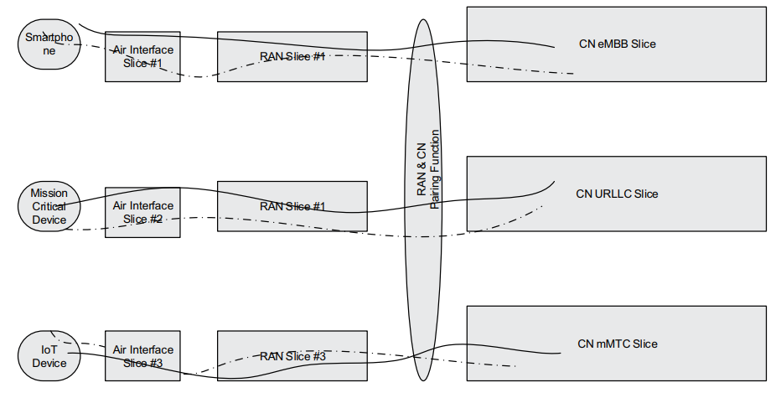
Network Slicing: Concept and Implementation;
E2E (end-to-end) slicing :- 1.1 Slicing in RAN
The slices in RAN may require slice-specific control-plane/user-plane and slice on/off operations.
What is eMBB ?
What is URLCC ?
What is mMTC ?

Slide 18
Network Slicing: Concept and Implementation;
E2E (end-to-end) slicing :- 1.1 Slicing in RAN
The slice in RAN will share radio resources such as time/frequency/space with other slices, along with the corresponding communication hardware either in a dynamic or static fashion according to the configuration rules.
The radio resource sharing is performed by a central scheduler that resides in the 5G base station.
If static resource sharing is used, the slice will get guaranteed resource allocation, while with dynamic resource sharing, usage is optimized.
The type and amount of RAN resources required for a network slice depends on the service such as mobile broadband, IoT, autonomous driving, and their respective QoS requirements, that is, high capacity, massive connections, and ultra-low latency, respectively.

Slide 19
Network Slicing: Concept and Implementation;
E2E (end-to-end) slicing :- 1.1 Slicing in RAN
As far as C-plane (control plane) and U-plane (user plane) configurations are concerned, three alternatives are possible.
Alternative 1 may allow a common C-plane across all slices and a dedicated U-plane for each slice.
Alternative 2 may provide a dedicated C-plane and U-plane for each of the slices, while the third alternative would be a case with a common U-plane and a dedicated C-plane for each of the slices.
Common C-plane slice functions include functions in idle mode such as paging, cell selection, and so on, while the functions in connected mode such as handover, dedicated bearer setup, and so on, can be categorized into slice-specific control plane functions.

Slide 20
Network Slicing: Concept and Implementation;
E2E (end-to-end) slicing 1.2 Slicing in Core Network
Traditionally, the core networks have been architected as a single network serving multiple purposes and have been tailored to one or more RANs while supporting backward compatibility and interoperability.
Network slicing, if implemented correctly, allows core networks to be logically separated making each core network slice operate independently while likely running on the same shared infrastructure.

Slide 21
Network Slicing: Concept and Implementation;
E2E (end-to-end) slicing :- 1.2 Slicing in Core Network
A key element of 5G architecture is the separation of control and user planes’ functions in the core network that allows selective choice of the U-plane functions needed for different slices and distribution of U-plane to sites closer to the devices, besides other features.
The C-plane is agnostic to many U-plane functions such as physical deployments and L3 transport specifics.
The control plane, as the name suggests, manages signaling messages, location information, cell selection/ reselection, and so on. The C-plane can be placed in a central location, making management and operations less complex, whereas the user plane can be distributed to a number of sites.

Slide 22
Network Slicing: Concept and Implementation;
E2E (end-to-end) slicing :- 1.2 Slicing in Core Network
By bringing the U-plane closer to the users, the round-trip time between user and network services can be shortened. U-plane functionality can be deployed to address specific use cases.
For example, an MBB (mobile broadband) service can be divided into video streaming and web browsing subservices which can be implemented by different feature sets within a network slice.
The slices can be defined to different support services/applications with a targeted set of radio/core network functions. Slice pairing functions are defined to pair RAN and core network (CN) slices to form end-to-end slices.
Mapping among devices, RAN and CN slices, can be 1:1:1 or 1:M:N, for example, a device can have RAN slices while a RAN slice can connect to multiple CN slices

Slide 23
Network Slicing: Concept and Implementation;
2. SDN and NFV in Slicing :-
SDN and NFV are essential for the effective working of network slicing.
SDN separates the C-plane and U-plane to optimize the performance of the network while NFV enables virtualization of networks
2.1 SDN Overview
The SDN architecture defined by Open Networking Foundation (ONF) enables a common architecture to efficiently support diverse slices tailored for different services with different requirements.

Slide 24
Network Slicing: Concept and Implementation;
2. SDN and NFV in Slicing :- 2.1 SDN Overview
The SDN architecture is technology neutral, thus it can support wired, wireless, and mobile technologies.
SDN consists of two key components, namely resources and controllers.
Resources could be anything, but in this case, it could be a physical network function consisting of a piece of hardware and software or a virtual network function (VNF) where the software is decoupled from the hardware for the realization of a particular slice.
Resources are managed through controllers which are central entities in SDN architecture.

Slide 25
Network Slicing: Concept and Implementation;
2. SDN and NFV in Slicing :- 2.1 SDN Overview
Resources are managed through controllers which are central entities in SDN architecture.
A controller maintains isolation in the control and data planes, allowing each network slice instance to be operated as a distinct and logically separate network.
It provides resource isolation as well for a multitude of slices running on a common infrastructure.
In addition to resources and controllers, the following key concepts are critical for the implementation of SDN based networks.

Slide 26
Network Slicing: Concept and Implementation;
2. SDN and NFV in Slicing :- 2.1 SDN Overview
• Virtualization is a function of a controller to abstract the underlying resources it manages.
Network virtualization assists in the creation of isolated virtual networks that are dissociated from the underlying physical network and run on top of it.
• Orchestration by definition brings disparate things into a coherent whole.
Within slicing, it is defined as the responsibility of the controller to dispatch resources to address the demands of the client in an optimal manner.
• Recursion, which could be hierarchical or federated, allows the controller to use resources from a lower level controller and provides services to a higher level controller (hierarchical scheme) while federation works on an equal level.

Slide 27
Network Slicing: Concept and Implementation;
2. SDN and NFV in Slicing :- 2.1 SDN Overview
SDN provides extensive control plane functions for enabling network slicing, however, to efficiently manage the lifecycle of slices and their constituent resources, NFV is needed.

Slide 28
Network Slicing: Concept and Implementation;
What is ETSI ?
2. SDN and NFV in Slicing :- 2.2 NFV Overview
European Telecommunications Standards Institute (ETSI)
ETSI NFV standard GS (Group Specification) NFV 002 defines the lifecycle management of network services.
A network service according to ETSI GS NFV 003 is a composition of network functions and is defined by its functional and behavioral specifications.
Thus, the concept of lifecycle management can be reused for network slicing.
NFV envisions the implementation of network functions as software-only entities (virtualization) that run over the NFV Infrastructure (NFVI).

Slide 29
Network Slicing: Concept and Implementation;
2. SDN and NFV in Slicing :- 2.2 NFV Overview
Virtualization means that the Network Function (NF) and part of the network infrastructure are implemented in software, that is, a decoupling of software from hardware.
This decoupling allows the independent evolution of each. Along the same lines, an end-to-end network service (voice, data, IoT, etc.) can be described by an NF Forwarding Graph* of interconnected NFs and end points.
To facilitate virtualization, the NFV reference architectural framework defined by ETSI can be used.
This framework enables dynamic construction and management of VNF instances.
It also manages the relationships between VNFs related to data, control, and other attributes..

Slide 30
Network Slicing: Concept and Implementation;
2. SDN and NFV in Slicing :- 2.3 SDN+NFV for Slicing
To take advantage of the benefits of both SDN and NFV for network slicing, an appropriate cooperation between the two is required.
However, integration of both entities into a common framework is not an easy job.
Consider a slice in LTE that may consist of a radio access component eNB, and core network components such as Mobility Management Entity (MME), Serving Gateway (SGW), Packet Gateway (PGW), and so on, to provide broadband to a population of mobile users.
The eNB is a PNF (physical network function) while other entities could be either PNF or VNF.
These PNFs and VNFs, which are resources as far as SDN is concerned, can be made part of the end-to-end network.

